Slide 1
Driver Drowsiness Detection System D3S
Final project presentation

Slide 2
Team Introduction – Group 1
Putrevu Manoj Niyogi
Maradana Vijaya Krishna
Sivasankaran Balakrishnan

Slide 3
Project Overview Why do we need?
“Driver Drowsiness Detection is a vehicle safety technology to help prevent accidents caused by
driver drowsiness”
National Highway Traffic Safety Administration – 100,000 crashes involve drowsy driving a year
AAA Foundation for Traffic Safety – 328,000 drowsy crashes every year
Lack of a real time monitoring system costs precious lives, costs $109 billions
Effective utilization of valuable resources
Safety, comfort and confidence

Slide 4
Project Overview
Solutions include
- Steering pattern monitoring
Monitors power steering
Exception - Automatic lane-keeping system
- Vehicle position lane monitoring
Uses lane monitor camera
Exception – Automatic lane-keeping system
Physiological measurement
Employs body sensors to measure brain activity, heart rate, muscle activity, etc.
Relatively expensive
Driver face monitoring
Monitors driver face using computer vision with camera
Simple and affordable

Slide 5
Project Overview Why did we pick present solution ?
A system works and continues to work smooth only when it is monitored continuously, and effective, corrective measures take place in time
Studies have shown strong correlation between fatigue and facial expressions and monitoring facial expression is a widely accepted method for detection driver drowsiness.
Drowsy Driving Prevention Week is Nov. 1-8, 2020 (https://www.nsc.org/road-safety/safety-topics/fatigued-driving)

Slide 6
Project Overview Why did we pick present solution ?
Audi – Rest recommendation system
BMW – Active driving assistant
Bosch – Driver drowsiness detection
Ford – Driver alert
Honda – Driver attention monitor
Hyundai – Driver attention alert
Jaguar – Driver fatigue alert

Slide 7
Project objectives
Study the requirements of problem
Research solutions, merits and demerits
Analyze feasibility and applicability
Detecting fatigue and drowsiness levels
Prepare a cost-effective fool proof driver alert system

Slide 8
Project scope
Functional Scope
Affordable by all vehicles
Automatic reporting to vehicle operators
Avoid major catastrophe
Technical Scope
Supervised / Unsupervised
Machine learning / Deep Learning
Hybrid machine learning / Ensemble approach
Intelligent systems / Sense making systems

Slide 9
Project Status Update
Scope Finalization (Completed)
Research (Competed)
Data Source (Completed)
Model Module (Completed)
Detection Module (Completed)

Slide 10

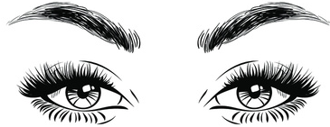


Bird eye view
Open
Closed
Image Acquisition
Matching
Feature Extraction

Slide 11










Technology Used Deep Learning Model
Read Image
Collect eye
images
Train
Get optimal weights
Deep Learning
Predict eye status
Open
Closed

Slide 12
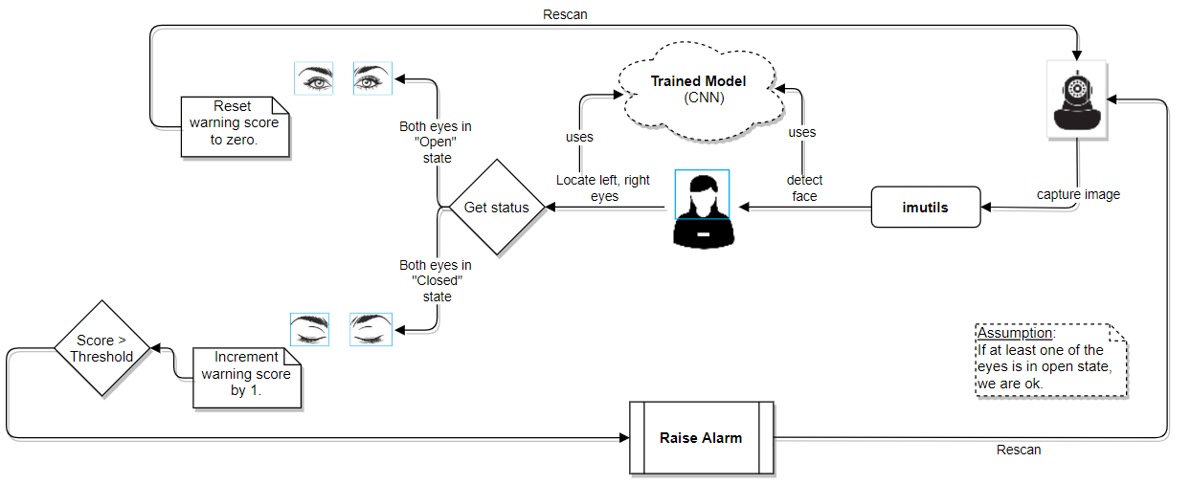
Approach

Slide 13
iBug Model
The source of the pretrained model we have used is from the iBug (https://ibug.doc.ic.ac.uk/) group of Department of Computing, Imperial College London. We used the technique, termed Transfer Learning, which is using the knowledge gained by a model that is well trained offline using real world data. The facial databases that are used include large collection of images of different subjects, poses, illumination, occlusions, etc. They have proposed a semi-automatic annotation methodology to annotate massive datasets to address issues with other techniques such as the following:
Some techniques provide relatively low annotations when compared to the volume of images
Low accuracy from few techniques
Varying annotation models with each database
These issues make cross database experiments and comparisons difficult or infeasible. The model that iBug suggests a 68-point markup for annotating facial features as shown in the following figure.

Slide 14
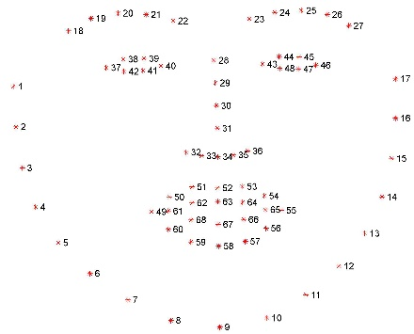
Facial feature detection technique
.
Left eye marking as 43 through 48
Right eye marking as 37 through 42
68-point mark-up used for annotations

Slide 15
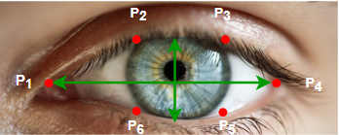
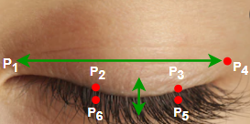
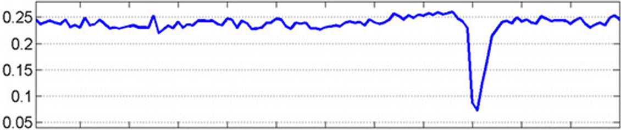
Facial feature detection technique
To be able to detect the state of eyes, we find the Eye Aspect Ratio of each eye. Each eye is represented by six marks each with (x, y) coordinates as shown
.
68-point mark-up used for annotations

Slide 16
Our Approach
Step 1 – We have used a laptop with web cam facility to capture the images from video stream
Step 2 – Laptop with python and PyCharm editor installed for programming
Step 3 – Download and place extracted pretrained model viz., from Shape Predictor accessible to the program.
Step 4 – Program in python to detect faces from the video stream.
Step 5 – Resize and transform the image captured into gray scale as we are merely interested in capturing the state of eyes and it does not matter if the image is color or gray scale.
Step 6 – Apply facial landmark localization to extract eye regions from the face.
Step 7 – Compute the aspect ratio to determine if the eyes are closed or open.
Step 8 – Trigger alarm if the aspect ratio is below the threshold value for preset duration

Slide 17
Limitations
Limitation – Assumes driver wears transparent glasses (not dark glasses obstructing structure of eye)
Lighting conditions
Camera quality
Positioning of camera
Driver’s cooperation (not wearing dark colored spectacles)
No matter how many advances, precautions we take we also know how to brake. After all we human intellectuals make and break!

Slide 18

Thank you

